Slide 1

Named Entity Recognition System for Biomedical Text
19L-2272 Shahood Bin Amir
19L-1218 Khursand Sohail
19L-2241 Taha Sohail

Slide 2

What is NER???
ER stands for Named Entity Recognition in Natural Language Processing (NLP). It is a subtask of information extraction that aims to identify and classify named entities in text into predefined categories such as person names, organizations, locations, dates, medical terms, etc.
The goal of NER is to automatically identify and annotate specific entities mentioned in text, enabling machines to understand the context and extract structured information. By recognizing named entities, NER helps in various NLP applications such as question answering, text summarization, information retrieval, sentiment analysis, and more.

Slide 3
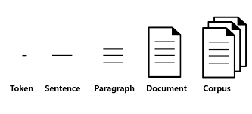
Step-1 Corpus Selection
BC5CDR (BioCreative V Chemical Disease Relation) is a corpus specifically designed for biomedical named entity recognition and relation extraction tasks. It is widely used in the field of biomedical text mining and NLP research.
The BC5CDR corpus contains PubMed(free search engine accessing primarily the MEDLINE database) abstracts and articles annotated with chemical and disease entity mentions, as well as their relationships. The corpus is annotated by human experts and provides labeled data for training and evaluating NER and relation extraction models in the biomedical domain.
Corpus Link.

Slide 4
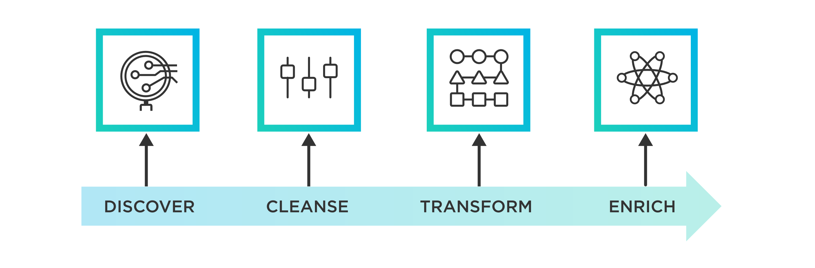
Step-2 Data Preparation
Clean and preprocess the biomedical text to remove noise and ensure consistency. This may involve removing special characters, normalizing abbreviations, or handling domain-specific challenges.

Slide 5
Step-3 Model Selection
Model Selection: Choose a model architecture suitable for biomedical NER. For example, you can utilize a transformer-based model like BioBERT or SciBERT, which are pre-trained on biomedical text, or adapt a general-purpose NER model like spaCy's en_core_sci_sm model.
Learn more about Biobert

Slide 6
Model Initialization
Use pre-trained BERT model for token classification: model = BertForTokenClassification.from_pretrained('bert-base-uncased', num_labels=num_labels) Modify the model's classification layer to match the number of entity labels in your dataset.

Slide 7
Step-4 Training
Define the training loop with the necessary data loading, batch creation, and optimization steps. Prepare the input data by converting sentences and labels into tokenized input features and label tensors. Perform forward and backward passes through the model and update the weights based on the computed loss. Repeat the training process for multiple epochs, shuffling the training data between epochs.
Split your dataset into training and validation sets. Fine-tune the selected model using the training data. Experiment with different training strategies, such as using transfer learning or leveraging domain-specific resources like ontologies or dictionaries.

Slide 8
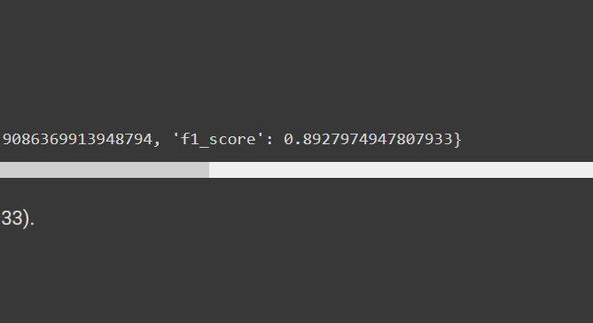
Step-5 Evaluation
Shall evaluate the model's performance on the validation set by calculating metrics such as precision, recall, and F1 score.
Shall make predictions on the test set and evaluate the model's performance.

Slide 9
THANK YOU!

